Slide 1
Automated Essay Grading System
Presented by: Janam Sarmalkar
Mohid Shaikh
Shivam Samaleti
Group No : 23

Slide 2
Concept
Based On Machine Learning and Natural Language Processing Techniques
Two Component System that includes
Construction of a Neural Network Grading Engine to grade Essays
Feedback System to help students improve further
Main Motive of the Project : To bring Quality Education more “accessible”
End Product will help in considerable reduction in essay grading costs while maintaining accuracy as well

Slide 3
Feasibility
Technical Feasibility - Does the group have the technological resources to undertake the project? Are the processes and procedures conducive to project success?
Schedule Feasibility - Does the group currently have the time resources to undertake the project? Can the project be completed in the available time?.
Resource Feasibility - Do the group have enough resources, what resources will be required, what facilities will be required for the project, etc.
Cultural Feasibility - What will be the impact on both local and general cultures? What sort of environmental implications does the project have?

Slide 4
Scope
AEGS has limited implementation as a web service. Hence deploying it online can be considered in the future.
Expanding this project to entrance exams can be made possible. Thousands of essays need to be evaluated during certain exams. Automating it would help reduce the workload considerably.
Our project focuses on English language. The target language can be changed by adding NLP libraries for certain languages, for eg. Indic NLP library which supports many Indian languages.

Slide 5
Research Paper Relation
Basic concept overview of Automated Essay Grading Systems.
Learning Vector Quantization analysis and NLP techniques.
Feedback generation mechanism.
Limitations of the current systems.

Slide 6
Implementation
Platform : MATLAB and Natural Language Toolkit (NLTK)
Languages : Python 2.7.x or newer
Other Software : Scikit and Libraries which includes numpy, scipy, xlrd, xlwt and Regular Expression (RE) library. Text Mining will be used for most NLP tasks.

Slide 7
Input Data Collection And Processing
Data set used to train our automated grading engine is obtained from kaggle.com, the data consists of essays written by students from class 7 to class 10.
The essays will be categorized and statistical data from the essays, such as word count, will be taken into consideration while processing.
Performance of the system will be evaluated using Quadratic Weighted Kappa which measures the agreement between two graders, 0 being random to no agreement and 1 being complete agreement among graders.
The data set used to train the model will consist of topic wise essays.

Slide 8
Reason for the topic to be kept on hold
The reason for the topic to be kept on hold was a doubt regarding data set content.
The content of the data sets used to train the system will consist of essays based and categorized topic wise, as opposed to domain wise as suggested earlier.

Slide 9
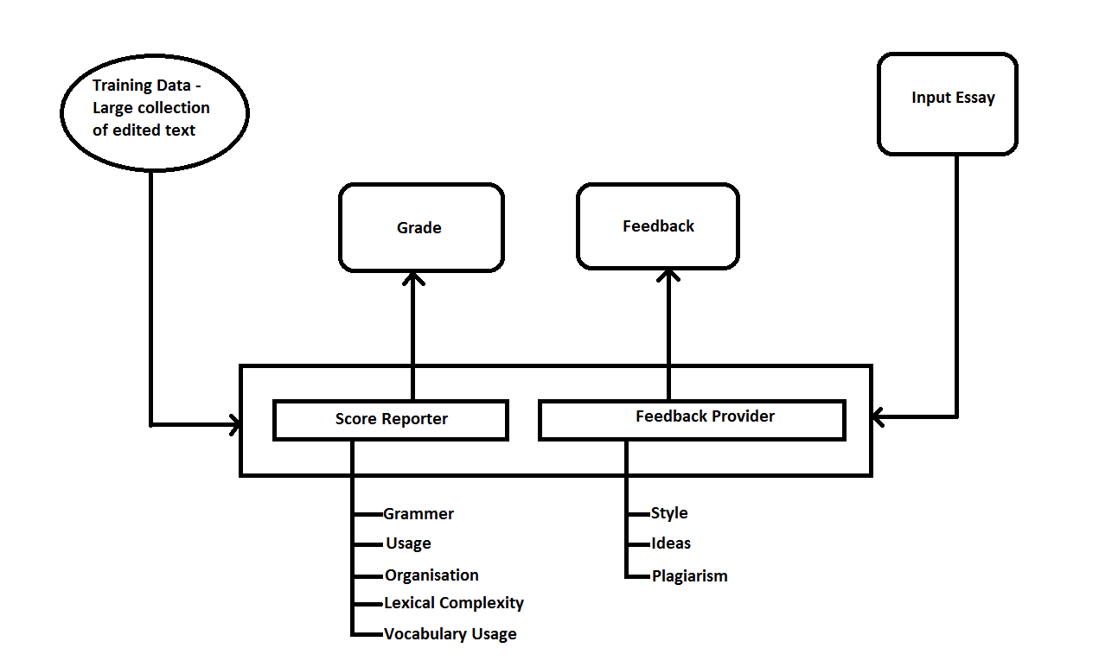
Block Diagram Overview

